Slide 1

Vintage Collectibles
Toys
Cars
Music
Dolls
Posters
Books
Clothes
Baseball Cards
Stamps
Coins

Slide 2
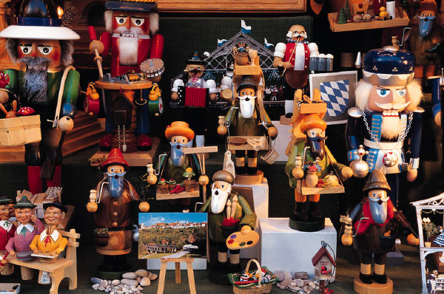
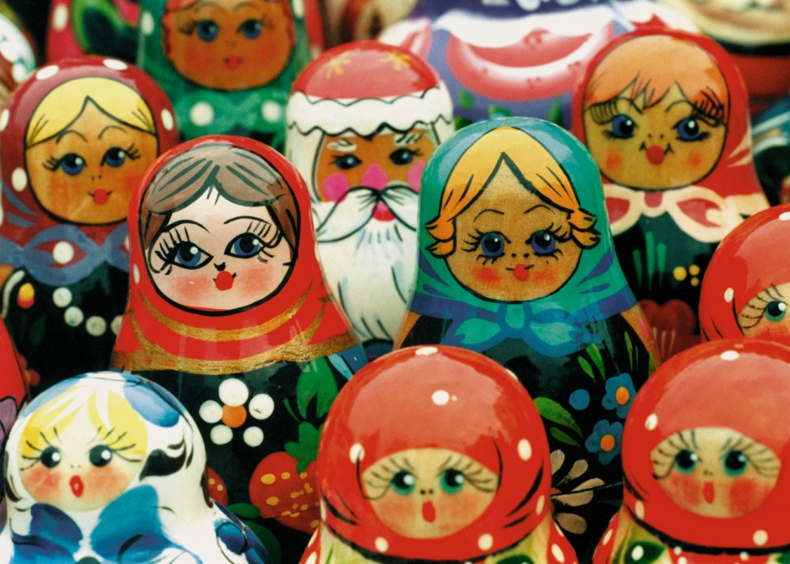
Rare Collectible Dolls
Largest collection of dolls in the state
Buy, sell, trade
Imported dolls
Vintage dolls
Action heroes and comic book figures

Slide 3
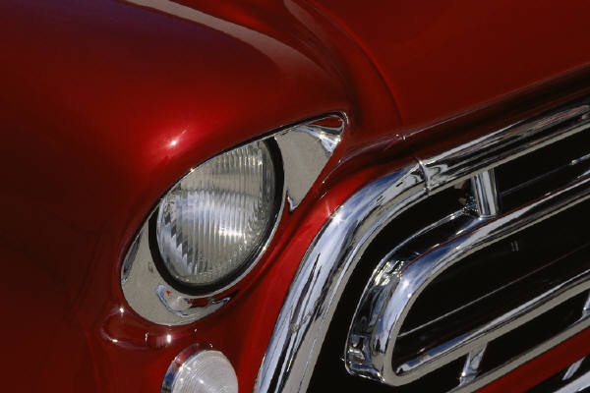
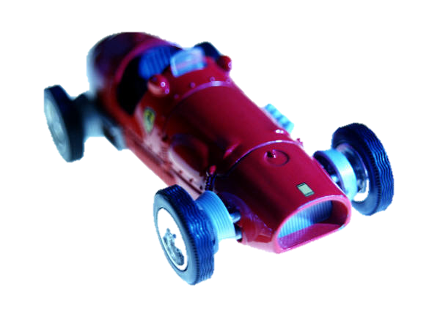
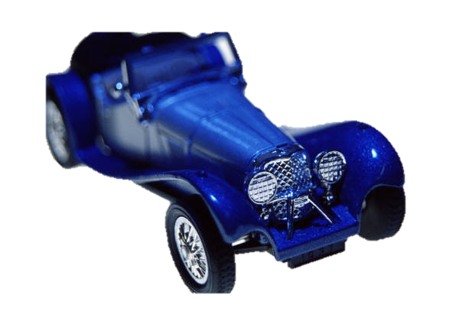


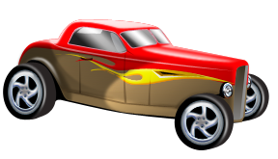
Model Cars
Die cast
Scale models
Vintage collectibles
RC
Toy racers
Hot Rods

Slide 4

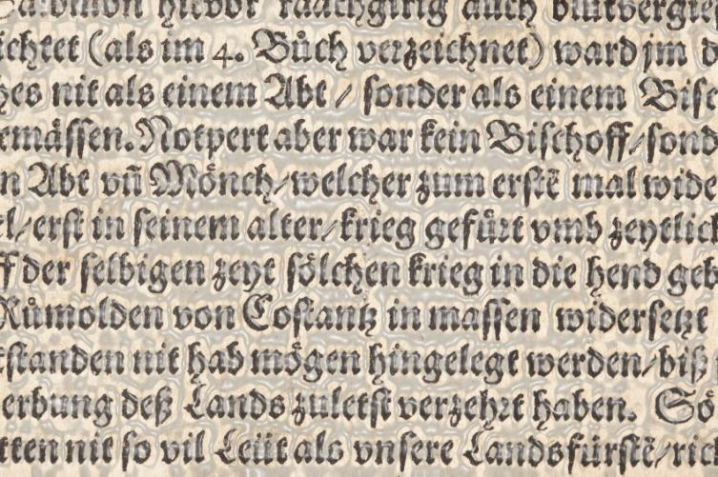
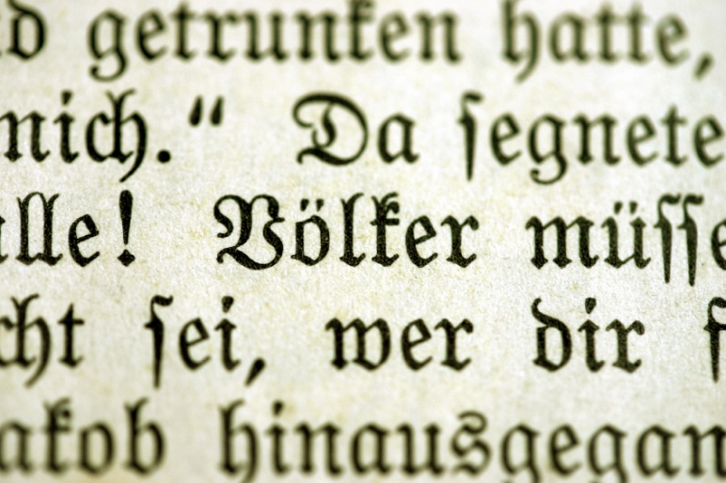

Books
Vintage and rare books
Out of print
Comic books
Graphic novels
Photo and art print collections
We pay top dollar for used books!

Slide 5
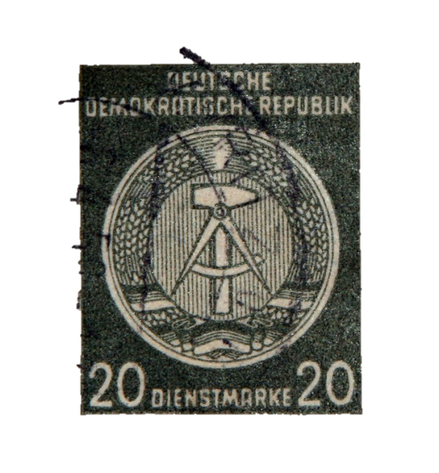
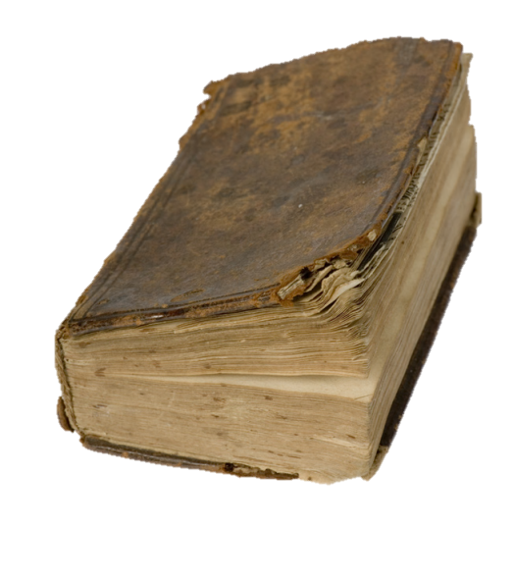
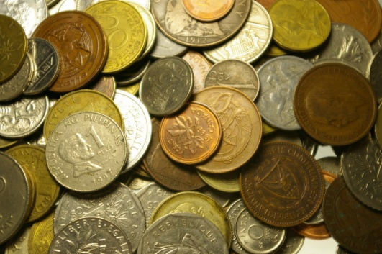

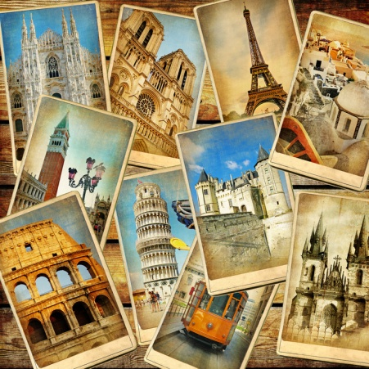
Other Collectibles
Stamps
Coins
Post cards
Records
Baseball cards
Spoons

Slide 6

Open 7 Days a Week!
We’re ready to make a deal!

