Slide 1
Video Production 101
Fall Curriculum

Slide 2
Unit 1
Equipment and Basics

Slide 3
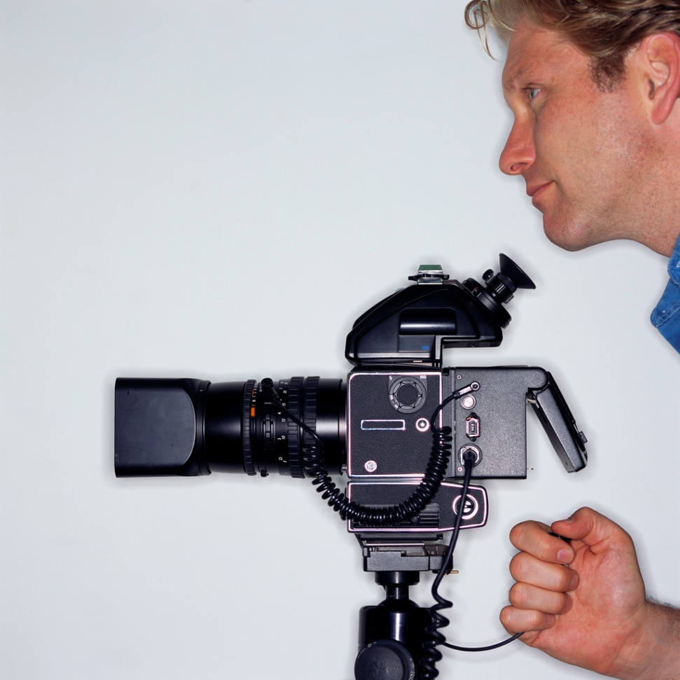
Before You Shoot
Cameras, lenses, and tripods
Framing, focus, and exposure
Focal length and depth of field
Lighting, batteries, and other peripheral gear
Tape, cards, and storage
Video file formats
Terminology

Slide 4
Week 1
Cameras, lenses, and tripods | Introduction to the various types of cameras used for television, film, and video production. Overview of lenses, their uses, their limitations, and how they affect the final shot. Overview of the basic studio and field equipment used to stabilize shots. Tripods, monopods Pedestals Dollies Jigs
Framing, focus, and exposure | The rule of thirds Composition Critical focus Aperture and F-stop Exposure
Focal length and depth of field | Lab: measuring the focal length of various lenses, and creating various effects using depth of field. Review equipment check-out policies and procedure. Sign student agreements.

Slide 5
Week 2
Lighting, batteries, and other peripheral gear | Overview of lighting equipment and concepts. Fixtures Reflectors Diffusers Filters Color temperature Care and use of batteries. Effects of temperature on charge.
Tape, cards, and storage | Overview of video storage. Film and its various formats Digital tape-MiniDV, DVC Pro, etc. SDI and other memory cards External storage Discs
Video file formats | Overview of common formats Frames and frame rates Aspect ratios

Slide 6

Fin
You now know the basics!

